Slide 1

ShowCase
Skill Sharing Web Application
Empowering Skills, Connecting Communities

Slide 2



OUR TEAM MEMBERS
MUNNA BISWAS
RIAD HOSSAIN
AISHARJO
221-15-5261
221-15-5249
221-15-5604

Slide 3

Project Objectives:
Facilitating skill exchange and fostering community engagement through a user-friendly online platform

Slide 4

Key Features:
User Profiles: Create, manage, and showcase skills & expertise.
Skill Exchange: Connect with others to learn or teach various skills.
Community Interaction: Forums, Q&A, and events for networking and collaboration.
Ratings & Reviews: Feedback system to ensure quality interactions.

Slide 5

Students seeking to learn new skills.
Professionals looking to expand their knowledge base.
Hobbyists interested in sharing passions.
Community leaders fostering local skill-sharing networks.
Who can benefit?

Slide 6
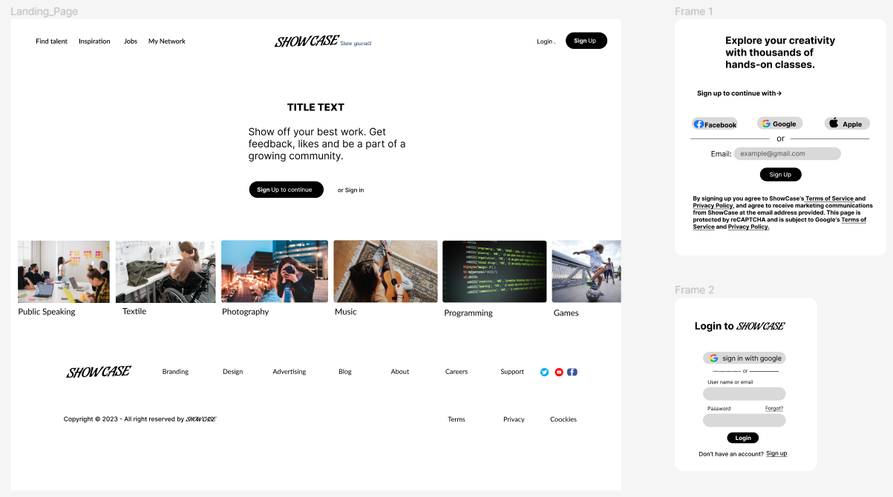
Project Overview
Landing Page

Slide 7
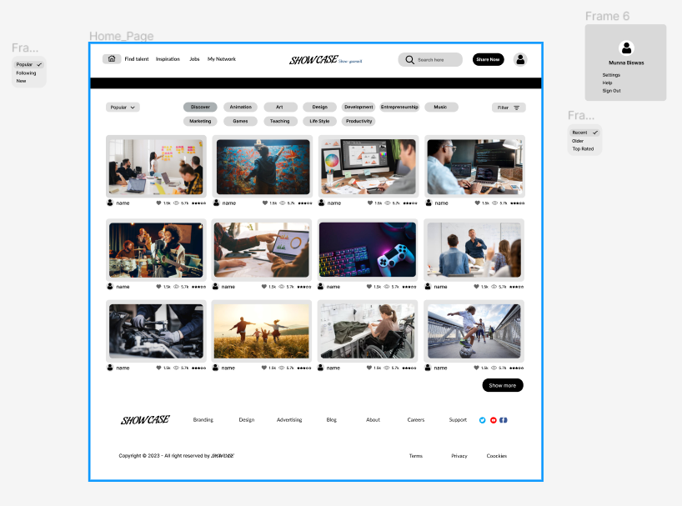
Project Overview
Home Page

Slide 8
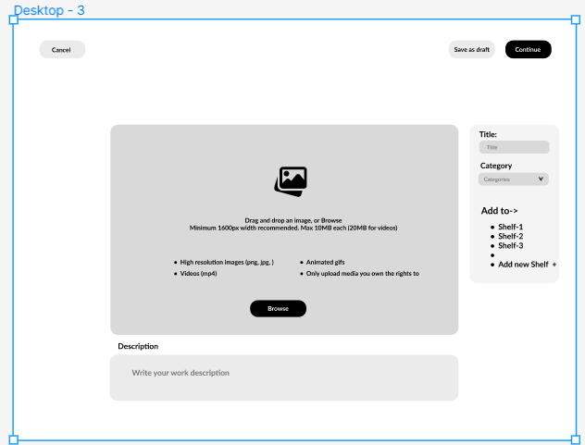
Project Overview
Sharing Modal

Slide 9
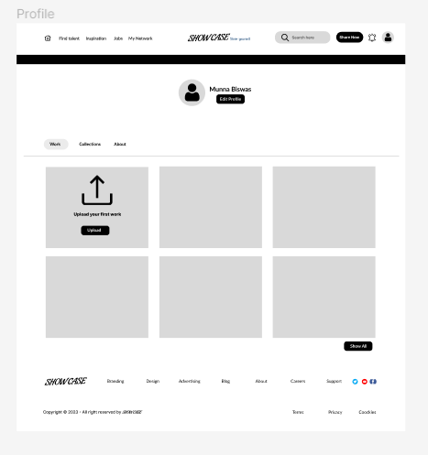
Project Overview
User Profile

Slide 10
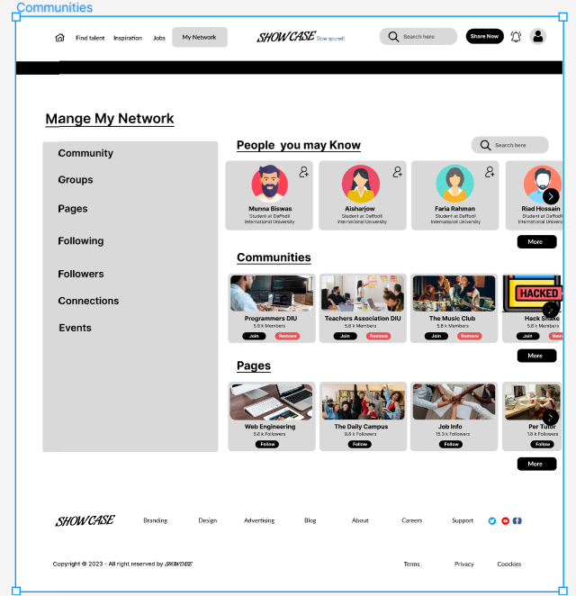
Project Overview
Users Communities

Slide 11
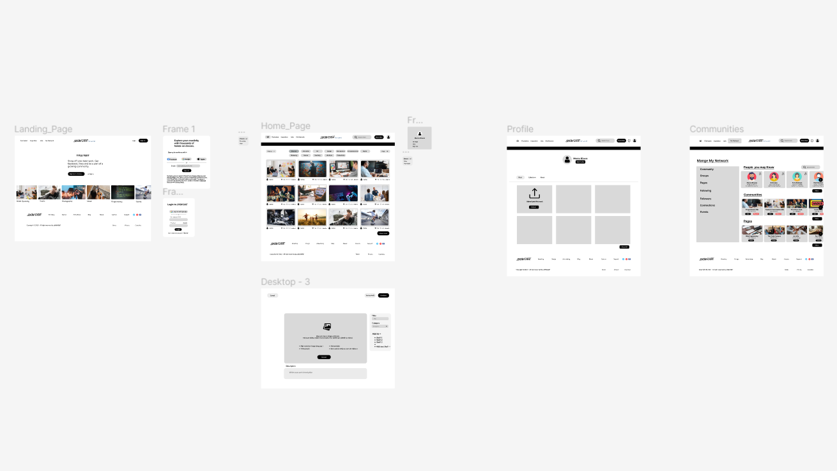
Project Overview

Slide 12
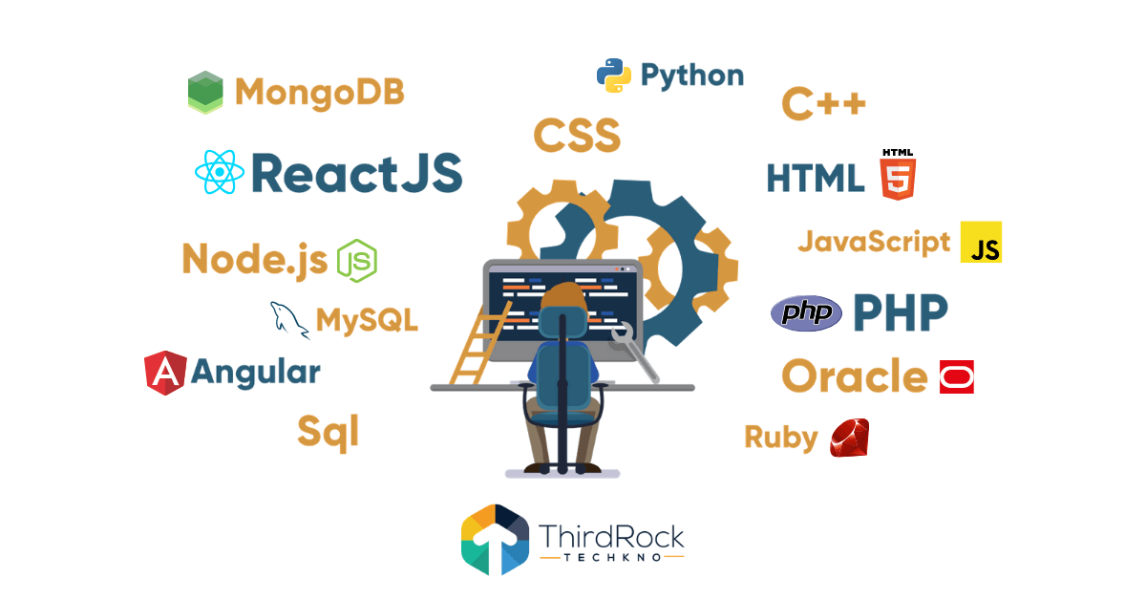
Tech Tools & Frameworks:
Frontend: HTML, CSS, JavaScript, React.js.
Backend: Node.js, Express, MongoDB.
Additional Tools: Bootstrap for responsive design, RESTful APIs for communication.
Technology Stack

Slide 13

Show Case
Development Phases
Planning & Research.
Design & Prototyping.
Frontend & Backend Development.
Testing & Iterations.
Deployment & Launch.

Slide 14

Show Case
Marketing & Growth Strategy
User Acquisition Plan: Social media campaigns, partnerships with educational institutions, SEO strategies, etc.
Community Building: Engaging users through content, events, and referral programs.

Slide 15
Show Case
Marketing & Growth Strategy
User Acquisition Plan: Social media campaigns, partnerships with educational institutions, SEO strategies, etc.
Community Building: Engaging users through content, events, and referral programs.

Slide 16



Show Case
Analysis of Similar Platforms
Skillshare, Udemy, Coursera, Meetup.
Overview of their core functionalities and user base.
Strengths and weaknesses of these platforms.

Slide 17
How ShowCase Will Stand Out?
Show Case
Personalization
Community-Centric Approach
Interactive Learning
Features Overview
User Experience
Personalized skill showcasing.
Building vibrant local communities.
Visual Comparison

Slide 18

Show Case
Conclusion
Show Case aims to revolutionize skill-sharing by fostering a vibrant online community.

Slide 19

Thank You

